Slide 1

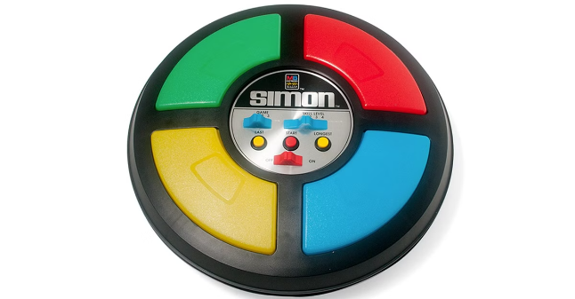
The Simon Game
The Simon Game is a classic electronic game that tests your memory and reaction time. It is a popular toy for children and adults alike and is known for its bright colors and simple but challenging gameplay.
by AtUl PeTwAl

Slide 2

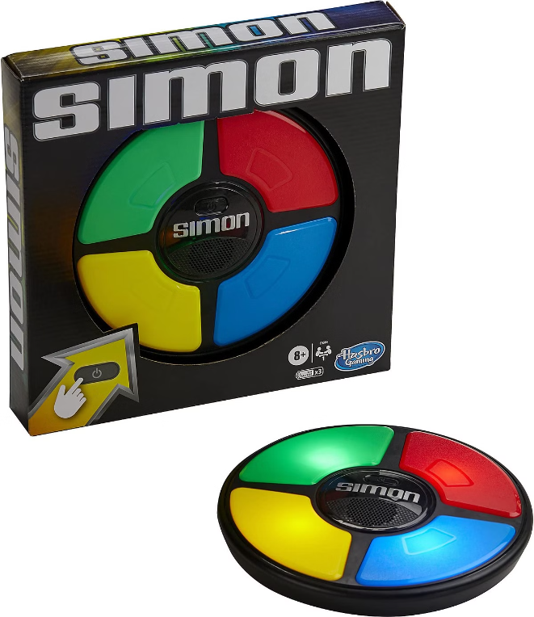
How to Play the Simon Game
1
Start
The Simon Game begins with a sequence of colored lights flashing in a random order.
2
Repeat
The player must then repeat the sequence by pressing the corresponding colored buttons in the same order.
3
Continue
The sequence length increases with each successful round, making the game progressively more challenging.
4
End
The game ends when the player makes a mistake or cannot remember the sequence.

Slide 3
Sequence Patterns in the Simon Game
Random Generation
Predictable Logic
Memorization
The Simon Game generates its sequences randomly, ensuring that no two games are exactly the same.
While the sequences are random, the game follows a logical pattern, with each color appearing roughly an equal number of times.
Players must memorize the sequences to succeed, improving their working memory and pattern recognition skills.

Slide 4
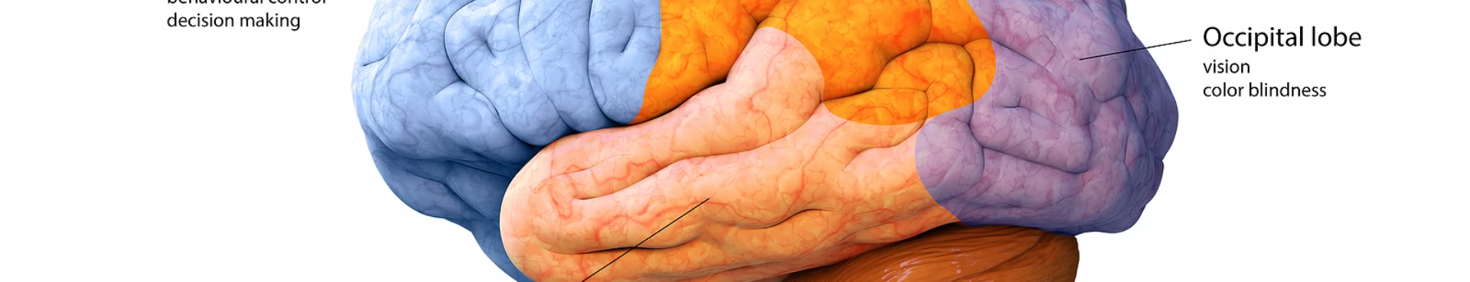
Cognitive Benefits of the Simon Game
1
Memory
2
Attention
The Simon Game challenges your short-term memory as you try to remember the sequence of colors.
It requires focused attention as you need to pay close attention to the flashing lights and your button presses.
3
Reaction Time
4
Cognitive Flexibility
The Simon Game encourages quick reactions as you need to press the buttons quickly and accurately.
It helps you switch between tasks quickly as you need to adapt to the changing sequence patterns.

Slide 5


Integrating the Simon Game into Education
Memory
Develops short-term memory and pattern recognition skills.
Attention
Encourages focus and concentration, improving attention span.
Cognitive Flexibility
Promotes adaptability and the ability to switch between tasks.
Problem Solving
Enhances analytical and logical reasoning skills.

Slide 6

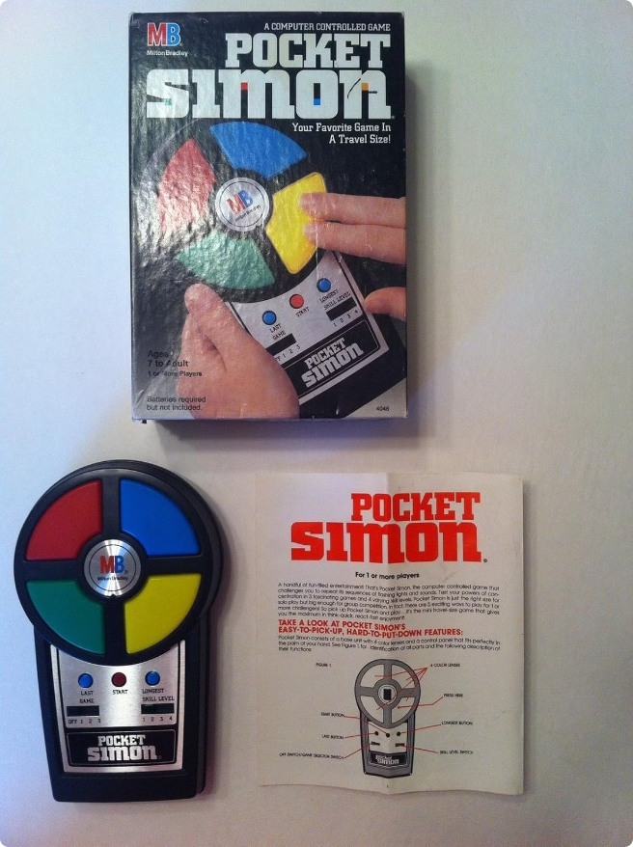




The History and Future of the Simon Game
Invention
Evolution
The Simon Game was invented by Ralph Baer in the 1970s, inspired by his work on early video games.
The Simon Game has seen various iterations over the years, with newer versions featuring more advanced technology and gameplay mechanics.
Virtual Reality
E-Sports
Future iterations may incorporate VR technology, offering an immersive and interactive experience.
The Simon Game could potentially become an e-sport, with competitive tournaments and professional players.

Slide 7

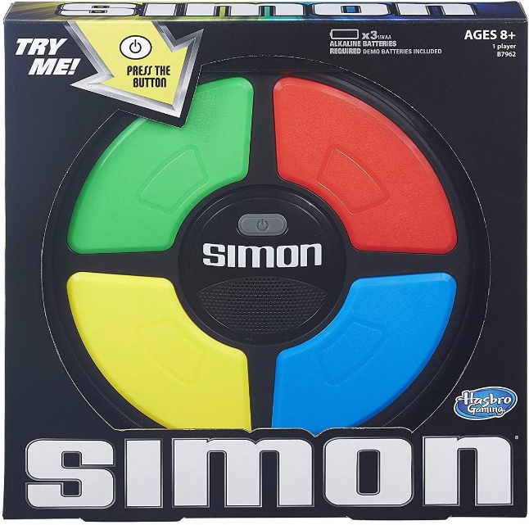
The Simon Game: A Legacy of Fun and Challenge
The Simon Game is more than just a game; it is a symbol of playful learning and cognitive stimulation. Its legacy continues to inspire innovation and provide a fun and challenging experience for generations to come.

